Slide 1
From Sunday, September 6th @ 10 am, via Microsoft Teams
Condensed by Nida Ansari, Marketing Coordinator

Slide 2
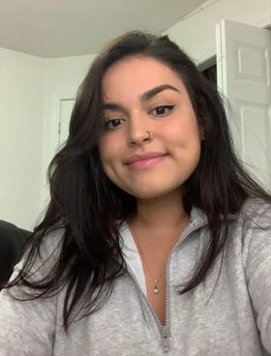
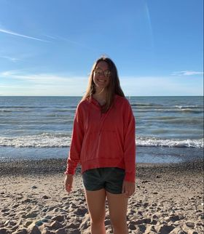
Introduction: Who Are We?
Sarah
Co-President
smarti26 @uoguelph.ca
Chloe
Co-President
demersc @uoguelph.ca

Slide 3
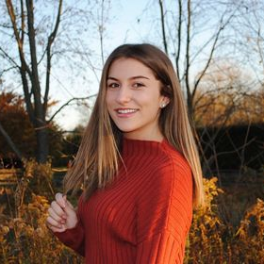
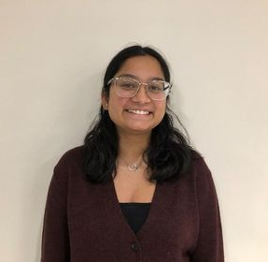
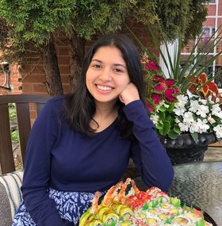
Introduction: Who Are We?
Tania (COCO)
tghuman @uoguelph.ca
Roslyn (COCO)
roelofsr @uoguelph.ca
Jessica (4th)
crosbyj @uoguelph.ca
Kaitlyn (2nd)
mendesk @uoguelph.ca
Nida (Marketing)
ansarin @uoguelph.ca
Tristan (4th)
tkimball @uoguelph.ca
Allison (ACCO)
purdya @uoguelph.ca
Renee (3rd)
rbelange @uoguelph.ca
Luis (3rd)
lechevar @uoguelph.ca
Kaelin (2nd)
kcook07 @uoguelph.ca
Agam (Board)
vermaa @uoguelph.ca

Slide 4
What is the Psychology Society?
Group of students majoring and minoring in Psychology
Student association that plans social and academic events for all psychology students and enthusiasts @ the University of Guelph!

Slide 5
Psychology Society vs. Psychology Department
Student-led organisation: event-planning, and representing each year/cohort
Professors and other staff in Psychology: academic advising, and teaching

Slide 6
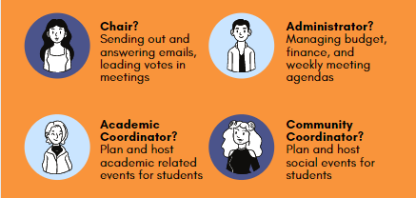
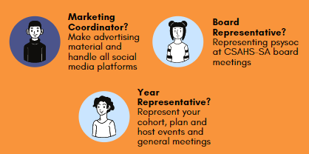
What do executive members on the Society do?
Together, we collaborate to bring you the best events and opportunities possible!

Slide 7
How will events be hosted this year?
We’ll be active on our social media and connecting with you as much as we can!
Alongside our events, we have general member meetings you can attend (keep up with our socials for dates and info)
Our events will continue to be online and remote for F20!
Merch – TBD for F20 but we’ll keep you updated!

Slide 8
How do I get involved as a member?
Guess what? You already are a member! ☺
As executive members, we plan and host the events.
As general members, you attend our events and give us feedback throughout the year!
Email psysoc@uoguelph.ca to be added to our email list for updates and important information!

Slide 9
What is first year like as a Psychology student?
Besides your chosen electives, you have 3 mandatory Psychology courses during first year:
PSYC 1000 | PSYC 1010 | PSYC 1500
Introduction to Psychology Your gateway to all things psychology! Covers the main areas like neuroscience, sensation and perception, learning, human development, personality, etc. | Making Sense of Data in Psychological Research Understanding and learning about different research designs and quantitative approaches. | Foundational Skills for Psychology Helps you figure out how to succeed as a Psychology student! Focus on skill development, communication, career planning, and more.

Slide 10
Psychology vs. Psychology Co-op?
General, Honours and Area of Concentration options for degree
Academic semesters only
Honours program
Both Academic and Work Semesters
Apply what you learn in professional settings
Visit your Academic Calendar for more information!

Slide 11
As execs on the Society, here were some of our favourite first year/psychology courses!
First Year Electives:
IDEV 1000 (Int’l Dev.)
SOC 1100 (Sociology)
CLAS 1000 (Classics)
UNIV courses (interdisciplinary seminars!)
Psychology Courses:
PSYC 2020 (Abnormal)
PSYC 2310 (Social)
PSYC 2410 (Beh. Neurosci)
PSYC 3100 (Evolutionary)
And much more!

Slide 12
On-campus jobs in Psychology and other opportunities?
Experience Guelph – on-campus and off-campus job portal (experienceguelph.ca)
Student Support Network (SSN)
Peer Helpers
Psychology Labs (check the Psychology department website)

Slide 13
Are you a current high school student looking to be a future Gryphon in the Psychology program?
Visit Admission Services for details about admission, requirements, grades, etc.!
admission.uoguelph.ca

Slide 14
Those were the main questions from our event!
Have a question that was not answered in this presentation? Ask us on our Instagram, Facebook page(s) or by email! See the next slide for more information.

