Slide 1
Poster Workshop: Preparing and Presenting a Scientific Poster
Workshop held in partnership with UofG PSYC Society
Notes:
Good afternoon everybody! Welcome to today’s workshop on creating and presenting a scientific poster brought to you by the Canadian Psychological Association in partnership with the University of Guelph’s Psychology Society.

Slide 2
Housekeeping Reminders
Please turn your microphones off if you are not speaking
Feel free to keep your camera on
Type your questions into the chat
Notes:
housekeeping
Some quick housekeeping reminders
To please have your mic off throughout the workshop
You can feel free to keep your video on if comfortable, if not keeping it off is okay too.
And lastly, you can type your questions into the chat, and we will answer these at the end of the presentation

Slide 3
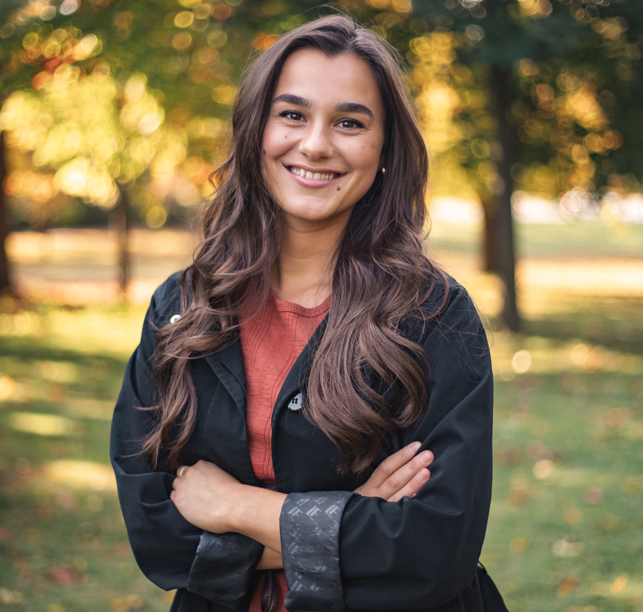
Presented to you by…
Kate Lupo-Flewelling
UoG Undergraduate Canadian Psychological Association (CPA) Representative
Tristan Kimball
UoG Psychology Society Representative
Jessica Crosby
UoG Psychology Society Representative
Notes:
They hold a scientific conference every year so we will be discussing how to
My name is Kate, and I am a fourth-year psychology undergraduate at the university of Guelph. I am your Undergraduate representative for the CPA where my aim is to communicate CPA related opportunities and information to the student body.

Slide 4
What is the Canadian Psychological Association?
Notes:
- The Canadian psychological association is a not-for-profit organization which acts as the voice of psychology in Canada. The CPA has a mission of advancing research, knowledge, and the application of psychology. Students receive discounted memberships with the CPA which allows you access to psychology-related resources and events!
The CPA also holds a yearly conference, which is one of the locations where you could present a scientific poster!

Slide 5
What words come to mind when thinking of scientific poster?
Go to www.menti.com and enter the code at the top of the screen​
Notes:
So, let’s start off with an activity brought to you by Tristan and Jessica!

Slide 6
Presentation Objectives
Why do a poster presentation?
General format & what to include
DOs and DON’Ts
General tips on font, color, & other
Notes:
This presentation will discuss firstly, the purpose and importance of a scientific poster presentation.
This will be followed by a general review of the poster format as well as what sections should be included on your poster, and the content and amount of information to include in each section
We will then cover some do’s and don’ts of preparing and presenting your poster
Lastly, we will discuss some general aesthetic tips to maximize the visual appeal of your poster and how to prepare to present it.
Today’s workshop will conclude with an activity and an opportunity to will some prizes thanks to the psychology society!

Slide 7
Posters are designed to…
Display information in a clear, concise manner
Generate interest to engage in a discussion
Aid as you discuss and explain your work
Stand alone when not available to provide explanations
Notes:
A scientific poster is a mechanism to communicate between scientists and to share our data to a broader audience.
This allows current research to be disseminated to others in the scientific community which will help progress our research.
Your poster should showcase your research ideas and fuel a conversation with the audience.
Your poster is a tool for presenting. It should provide jump-off points which act to create a discussion with your audience. As you explain your research, your poster should support your talking points.
When done effectively, it can provide a concise and attractive summary of your project
Although your poster should be concise, it should be able to convey your message without you there. The narrative, or main points of your research should be instantly clear for your audience by scanning your poster.

Slide 8
General Guidelines
1. Dimensions
Adjust dimensions depending on size of poster
Typical: 48" x 36" poster in landscape orientation
2. What to include (APA 7th Edition):
Title banner
Abstract
Introduction
Method
Results/Discussion
Conclusion
References
Contact Info & Acknowledgements
Notes:
So, we will continue with some general poster guidelines
The dimensions of your poster should typically be 48” by 36”, with is 4 feet by 3 feet but may vary depending on an event’s specifications so always be sure to check whether there are specific guidelines for an event.
Based on APA 7th edition guidelines your poster should include a title banner, an introduction, method section, a results and discussion section, a conclusion, you may wish to include references, contact information and acknowledgements.
I will go into more detail about what to include in each of these sections in the upcoming slides.

Slide 9
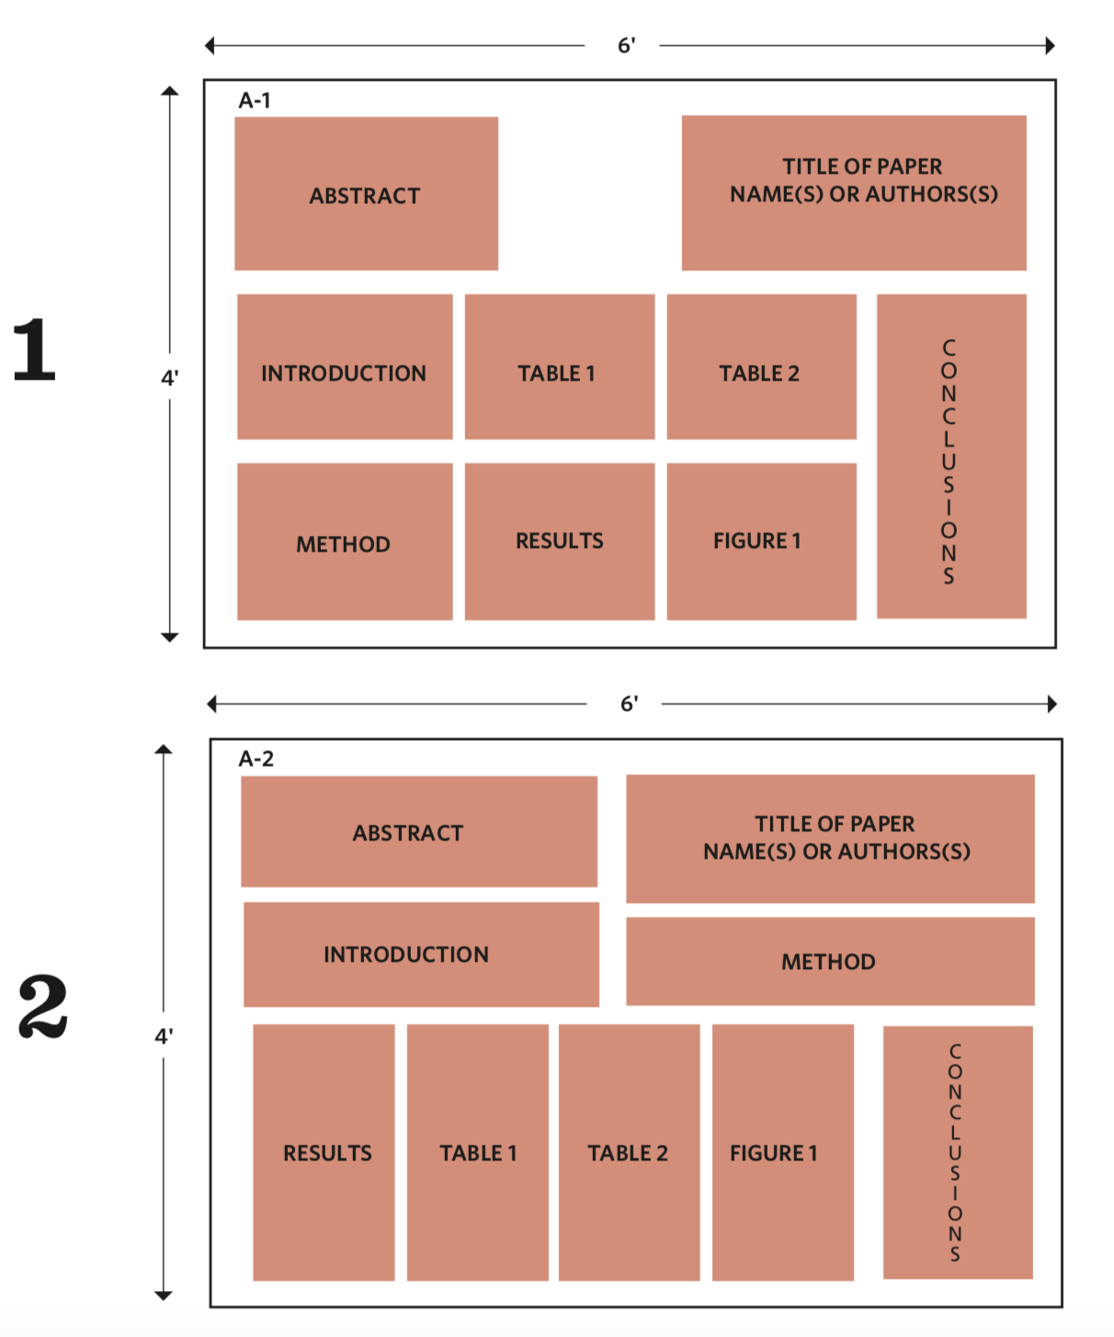
Sample Poster Arrangements by APA
https://www.apa.org/convention/poster-instructions.pdf
Notes:
Here we have two sample poster formats from APA
One very important thing to notice about these layouts is that they present the ideas in a logical order. You should make sure that it is clear to readers where to start on your poster, and where to end. In both example formats, you can see that the sections of the poster flow in the order that a scientific paper would. This allows the audience members eyes to move from left to right, as if they were following your scientific paper from beginning to end.

Slide 10
Poster Sections & Contents…
Notes:
So now we will discuss the sections and content included on a poster using an example.

Slide 11
https://www.mghihp.edu/poster-presentations-age-zoom
Notes:
Title: Your title should be 2 lines maximum, and the authors and affiliations of the project should appear under your title. The title should use plain language and aim to grab the audience’s attention.
Abstract: You should not include an abstract on your poster unless specified. An abstract in this case is redundant because a poster is already a succinct description of you work!
Introduction :The introduction section should get people interested while providing your project with some context. Only include absolutely necessary background information and avoid technical definitions.
The introduction should also succinctly place your issues in the context of existing research – ask yourself how your topic fits into existing research.
You should also state your objectives here.
*The eligibility section on this poster highlights the customizability of a scientific poster depending on the nature of the research it represents. The inclusion of the sections discussed here are general requirements, but each poster may contain different aspects of each of these sections depending on the project.
Methods: The methods section straightforwardly should detail your participants such as the size of the sample and any relevant demographic details.
It should also include the procedure which can be done with a step-by-step diagram, and the relevant measures.
Results: The results section is often the largest section which should include firstly a detail of initial characteristics such as the descriptive statistics. You should then include the data analysis, stating your hypotheses and which analyses you used to investigate these. To present your findings, you can use visuals such as tables, charts, and figures. Remember that all of your visuals should follow APA guidelines when formatting, such as labels and titles.
Discussion: The discussion section can re state the research objective and provide a concise summary of the results. In this section you can also state the implications of these findings, as well as provide future directions for this research
References: Only include references integral to your study. These can appear in a smaller font than the main body text. I will discuss font size guidelines in an upcoming slide. Another option is to not include a reference section on your poster, but to have smaller versions of your poster printed to hand out to people, with the references printed on the backside. In regard to in-text citations, these should be included where necessary throughout the poster (so probably mostly in the introduction section)
Acknowledgements: Acknowledgements can mention special contributions and sources of funding
Contact information: For your contact information, you can include your email.
*Notice that the colour scheme of this poster matches the logo. This is a great idea if you are including a logo on your poster to make the poster look visually cohesive and appealing.

Slide 12
https://glimages.s3.amazonaws.com/image/makesigns/sciposters/better-poster-sections.png
Notes:
There is variability in the layout that you choose. The poster in the previous example, is a more traditional approach to creating a poster. The layout on this slide is a more modern layout. Before I discuss this layout option, it is important to note that your choice in poster design depends not only on your preference, but also on the preference of your supervisor. So always make sure to discuss with your supervisor their expectations!
This is an example of a modern poster layout which aims to minimize the amount of text on the poster, providing the audience with a clear indication of the intention of the project. This approach to poster making highlights a major takeaway of the project, while still providing an overview of the study on the side columns. On the left side column an outline of the study can be found, and visual aids are located in the far-right column. If you chose to use this layout, there are two important things to consider. Your poster should provide enough information that you can be absent and someone who knows little about your area of research can still get a comprehensive picture of your study. And secondly, how your poster flows should be clear. So where should the audience member begin and end?
Also, one nifty aspect of this poster design is the inclusion of a QR code. It is possible to create a QR code which links your entire research paper for people who want more information. And QR codes are surprisingly very easy to make. At the end of this PowerPoint, we will provide you with a few helpful resources, one of those being a link for a tutorial to create a QR code.

Slide 13
DO’s
Keep it simple!
List sentences & bullet points
Aim for 800 words (or less)
Set headings in bold
Use italics vs. underline
Keep line spacing at 1
Leave space between poster elements
Aim for symmetry/balance
Make text legible at a distance of 6 to 10 feet
Notes:
Now let’s move on to some do’s and don’ts of scientific poster making!
Simplify your language as much as possible.
You do not need to include all of the information you would in a manuscript, and you do not need to use full sentences. The use of bullet points is encouraged.
Your poster should include a maximum of 800 words, this varies depending on who you ask, some say 200 words maximum. But I would say 800 words is the absolute maximum!
Your headings should be bolded
Underlining words and phrases on your poster can make it look messy. Instead use italics!
Although you may be used to double spacing text when writing papers in APA style, your poster should be single spaced
Let your poster ‘breathe’. Do not be afraid of white space, without the use of white space, your poster will look cluttered. Close to 40% of your poster should be blank.
Your poster should look balanced. Not cluttered on one side and empty on another.
A good rule of thumb is to have everything visible from 6 to ten feet away.

Slide 14
Don’ts
Making it too long/densely packed/excessive text
Blocks longer than 10 sentences
Jargon, abbreviations and acronyms
Colored background in your graphs
3D graphs
Default formatting for charts (rarely appropriate)
Including anything you aren’t able/prepared to talk about
Notes:
Here are a few things you should not do when creating your poster!
I would say that the number one negative for recipients of a poster is when it has too much text! Too much text can make it difficult for a person to know where to begin, preventing them from learning the most important things about your research.
Keep each section to an absolute maximum of ten points.
Abbreviations, acronyms, or some form of field-specific lingo will not go over well with people who are not as expert as you are on your research topic so write out those terms in full, in the simplest form that you can.
Although an image background, or a coloured background may be fun, it is distracting. Stick to a white background behind your information. If you are presenting your poster at an in-person conference in the future, white is also the cheapest to print.
Keep your graph simple, do not use 3D graphs.
Lastly, you should not include anything on your poster that you are unprepared to speak on because someone may ask a question about this and a fumbly unsure answer may look unprofessional.

Slide 15
General Tips - Font
Do not use more than two font types – distracting
Common: Arial and Verdana
DO NOT USE UPPERCASE
Size: start at 24-36
Font Guidelines:
Title: 72 to 85pt
Authors: 46-56pt
Sub-headings: 36pt
Body text: 24pt
Captions: 18pt
www.makesigns.com
Notes:
Now let’s talk about font and colour use on your poster.
The maximum number of font types on your poster should be 2! Also, graphic fonts and uppercase font can be distracting from the purpose of your poster, so avoid the use of these two things. These can both come off as unprofessional to your audience.
When we are talking font sizes, the smallest font size on your poster should be 18 pt.
General guidelines for font size should be as follows. Your title should be the biggest written piece, between 72 and 85 pt font. Below this should be the authors names, in 46 – 56 pt font. Your subheadings will be typically 36 pt font, the body text under these headings will be 24 pt font, and captions and references are 18 pt font.

Slide 16
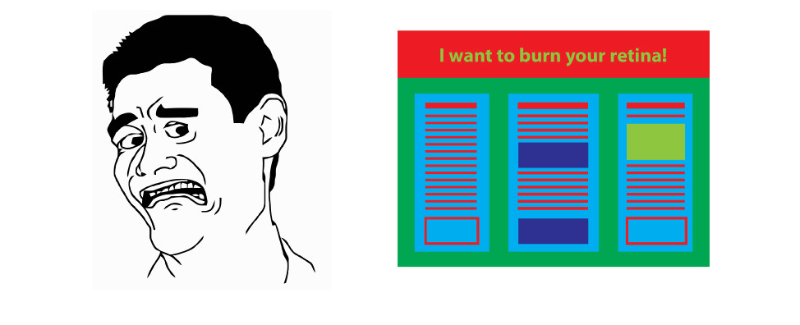
General Tips - Colour
Use two to three colours, avoid red/green, try for dark colours against white
White space is good!
Background and text – high contrast
What looks good on screen may not on print
www.makesigns.com
https://www.animateyour.science/post/how-to-design-an-award-winning-conference-poster
Notes:
Intentionally chose how you will use colour. Use the right colour palette, in other words, do not use colours that clash in a way that is painful to look at or hard to read. Avoid the use of bright colours, including red and lighter greens. The use of these colours is likely to overpower the information on your poster. The use of colour should complement your information, not take away from the message
You want a dramatic contrast between font and colours used. For instance, a dark title banner with white writing looks visually appealing.

Slide 17
Presenting
Have a 1-, 3- and 5-minute talk ready
Engage with people as they walk by (e.g., Would you like me to run through my poster?)
Make it easy for a person who is not familiar with the project to understand it quickly
Be prepared to answer questions, have supplemental materials ready
Have handouts available
Notes:
Let’s get to presenting your poster. So, you’ve successfully made your poster and are now preparing to present. What does this look like?
First, let’s talk about why you might want to present your poster. Presenting a poster allows you to develop your communication and presentation skills through practice. You will gain experience presenting your work to a broader audience.
Presenting your research to other researchers is a good way to get feedback from faculty, peers, experts. Others may ask you questions that you have never thought of, which may provide direction for your future research
In regard to preparing your presentation, you should prepare a 1- minute, 3- minute and 5-minute talk
Your talks as well as your poster, should make it easy for a person to become quickly familiar with your project
As people walk past your poster, engage them! Ask them if they would like you to run through your poster.
You should also be prepared to answer questions about your research.
Have supplemental materials ready. A great idea is to print out smaller copies of your poster – which can include references on the back. You could include your contact information on these, or you can bring contact cards with you to hand out when necessary!

Slide 18
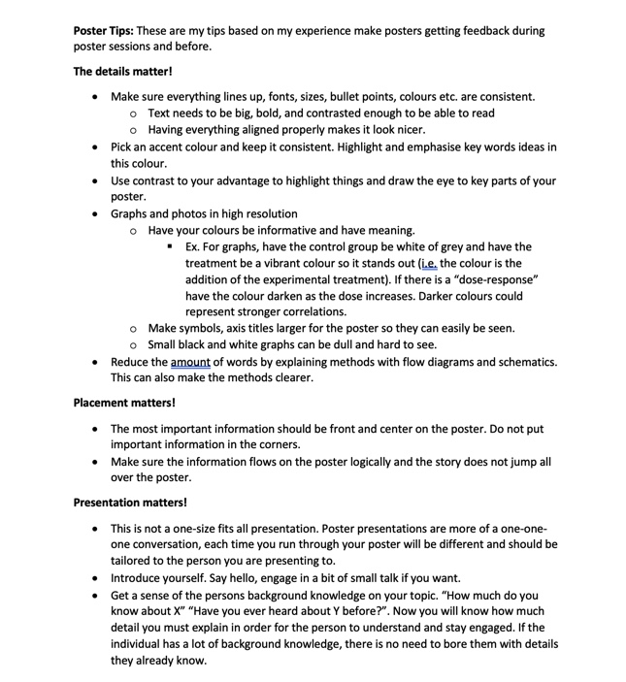
Poster tips from a graduate student:
Notes:
Marieka is a graduate student at the University of Guelph and has won awards for her poster presentations. Here are her tips for an excellent poster. You can go through these ones on your own time!

Slide 19
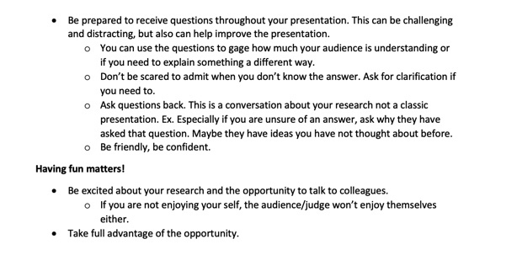
Poster tips from a graduate student cntd:

Slide 20
Incredible Resources
Tips on how to present a scientific poster, and the importance of attending conferences:
https://www.youtube.com/watch?v=0ozwCEeaVWE
A step-to-step tutorial to make a scientific poster in PowerPoint:
https://www.youtube.com/watch?v=_WnhoIbfcoM
Poster layout guide from the University of Guelph Library:
https://drive.google.com/file/d/1OoCHc0AtAhGBwI3hbcDreO7fUDZWODgm/view
How to create a QR code:
https://blog.hubspot.com/blog/tabid/6307/bid/29449/how-to-create-a-qr-code-in-4-quick-steps.aspx
Notes:
- Here are some more resources. Tristan will include a link for these references in the chat. Links for general tips and more information on conferences, a step-by step tutorial to make a scientific poster in powerpoint, a poster layout guide from UoG’s library resources, and also a page on how to create a QR code if interested are all provided here.

Slide 21
Activity: Evaluate the Poster
Go to www.kahoot.it or download the Kahoot! app and enter the game pin on the screen​
1st, 2nd, and 3rd place winners will win an e-gift card prize!
Notes:
Now the Psyc Society will run an activity on Kahoot!

Slide 22
Thank you for attending!
For a copy of this PowerPoint, contact klupofle@uoguelph.ca
Notes:
Thank you all very much for taking the time to attend this workshop! If you would like to use this powerpoint as a resource to create a poster, email klupofle@uoguelph.ca for a copy of the presentation.

